Slide 1

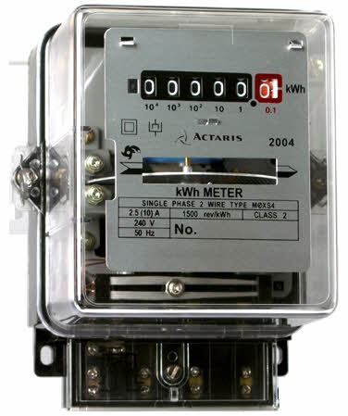







Every Month Family Need’s
House Rent
Current Bill
Water Bill
Milk
Vegetable
General Store
School Fee’s
E M I’s
Function’s, Small Trip’s, Entertainment,
Medical’s etc…….
Every Month Expenses
Rs. 30,000/- To Rs. 50,000

